Slide 1
Flexi Work

Slide 2
Agenda
Problem Statement
Project overview
Application features
Project Timeline
Team
Technology stack
Flow Diagram
Project Demo
Conclusion
Future enhancements

Slide 3
Problem Statement
A large company with thousands of employees faces issues managing essential resources.
Resources such as workspaces, parking slots, and employee events are managed manually
Workspaces often double-booked or unused due to scheduling errors

Slide 4
Project overview
The project is about creating a system that helps a large company manage workspaces, parking slots, events, and employee feedback more efficiently.
If these tasks are done manually, leading to confusion and wasted resources

Slide 5
Application Features
Admin features:
check all Employee details
check all workspace slot and booking details
check all parking slots and booking details check all Event venue and booking details
check all vendor stall and booking details
check all Feedback
Employee features:
Book or Cancel a Parking slot
Book or Cancel a Workspace slot
Register for a Event
give Feedback

Slide 6
Application Features
Manager features:
Book or Cancel a Parking slot
Book or Cancel a Workspace slot
Organize an Event
give Feedback
Vendor features:
Book or Cancel a Vendor Stall
Security features:
view and cancel parking slot
Other features:
JWT authentication and secure routing.
Image storage via Cloudinary (Public API)
Reset Password

Slide 7
Project Timeline
24-OCT
26-OCT
27-OCT
3-NOV
5-NOV
INITIATION
PLANNING
EXECUTION
CONTROL
CLOSURE
Defining the project scope, objectives, and deliverables
Detailed project plans created, including development of work breakdown structure.
Project tasks are performed, and the project plan is put into action.
Progress is monitored, and any deviations from the plan are identified and addressed.
Documenting deliverables, conducting reviews, transitioning outcomes.

Slide 8


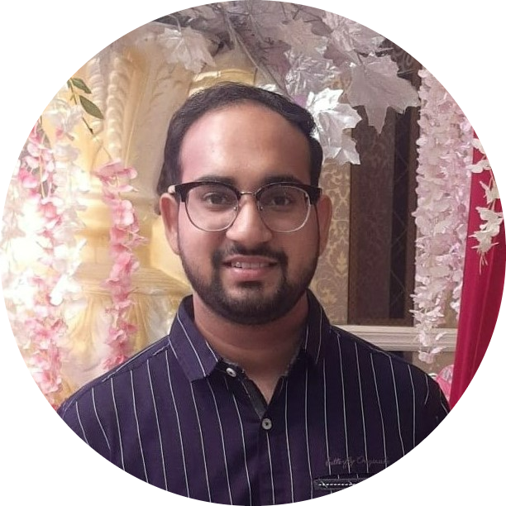

Sudeep N Naik
The Team
Shreya Gupta

Slide 9
Tech Stack

Slide 10






Frontend
Backend
Database
Dev-tool

Slide 11
Flow Diagram

Slide 12

Home
Login
Role ?
Employees
Admin
Manager/Employee
Parking
Parking
Workspace
Vendor
Security
Workspace
Events
Vendor Stalls
Parking
Event Venues
Vendor Stall
Feedback
Logout

Slide 13
Project Demo – Flexi Work

Slide 14
Conclusion

Slide 15
Reduced confusion and improved resource utilization.
A seamless experience for employees and event organizers.
Enhanced employee engagement through smoother event management.
Admin Dashboard and Analytics
Real-Time Tracking and Booking

Slide 16
Future
Enhancements

Slide 17
Implementing Notification System
Employee Work hours Monitoring

Slide 18
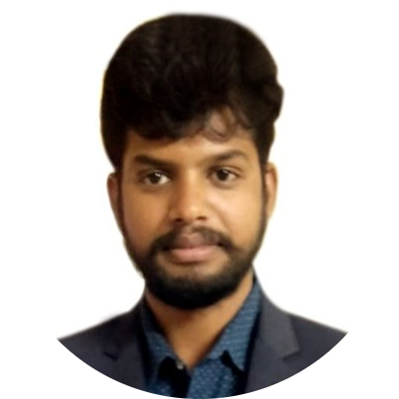
Sharath Kumar
I want to take the time to look back on a truly awesome training session that I had the pleasure of meeting during my time teaching with your team and make more productive interactive. It was a great job done and I really like the involvement of each participant in the production environment .I am glad that I am lucky to have these participants and thanks to Publicis sapient team always supportive .Best Luck for your future endeavors
Trainer Testimonials

Slide 19
Thank You

